Slide 2
TIROCINIO
STAGE
INTERNSHIP
TRAINEESHIP

Slide 3
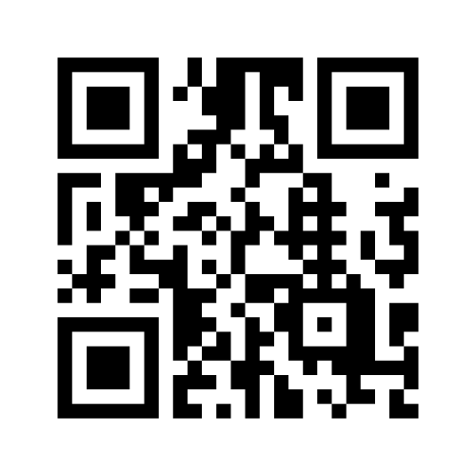
WHAT AN INTERNSHIP IS FOR YOU? Tell us in 3 words!
https://www.menti.com/vzypar38uj

Slide 4
WHAT AN INTERNSHIP IS FOR THOSE WHO DID IT?
1191 AUIC School’s Master Degree interns in 2021:

Slide 5
WHAT AN INTERNSHIP IS, REALLY?
It’s an on-the-job experience, outside the university context!
It allows you to «put into practice» theoretical knowledge acquired studying
It is a practical training experience, always supported by a professional: IT’S NOT A JOB CONTRACT!
It allows you to «try» doing a job, to understand if it is what you want to do in the future
It allows you to enrich your curriculum vitae before the graduation, making it unique from that of your fellow students

Slide 6
WHAT TO EXPECT FROM THE HOST ORGANISATION?
TRAINING and SUPPORT
RULES APPLICATION
POSITIVE EXPERIENCE

Slide 7
WHICH ARE THE BASIC RULES OF EVERY INTERNSHIP?
WHO | TYPE | LENGHT | STARTING WHEN | BENEFIT | MANAGED BY
STUDENT (Bachelor and Master, Specializing Masters, PhD) | Compulsory (gives you university credit – ECTS) | Depends on your study plan | Depends on your study plan | Paid or unpaid | “SAT”
 | Non compulsory (no university credit) | 1-12 months | Whenever you are ready/available | Paid or unpaid | CAREER SERVICE
GRADUATE (Bachelor and Master, Specializing Masters, PhD) | Extracurricular / Post graduate | 2-12 months | Whenever | Paid (Italy) or unpaid (Abroad) | CAREER SERVICE

Slide 8
PC, programs and internet connection are the host organisation’s duty; it is partially an exception the smart working internship
Insurance coverage for accidents and civil liability, on the intern’s activity, are PoliMi’s duty
Hours and days of attendance must be respected: no overtime, no activity during the night or in the weekend.
The host organisation must provide you each necessaary specialist training course.
For the host organisation and PoliMi

Slide 9
Follow the instructions by the supervisor
Follow the host organisation’s internal rules and purposes
Attend according to the agreed schedule, notifying (if possible in advance) any abseces
Pay attention to the obligation of secrecy, asking the supervisor if ok to the disclosure (eg. In the thesis/final evaluation)
For the intern

Slide 10
DID YOU KNOW… ?
Intern
Company supervisor

Slide 11
Intern
Academic supervisor!
- You choose him/her when you find the internship
- He/she must approve the internship before starting
- You can ask him/her support for technical or scientific counselling and any problem with the Company
- He/she will validate your ECTS at the end of the internship
Company supervisor

Slide 12
8 PRACTICAL TIPS TO LIVE AT BEST THE INTERNSHIP EXPERIENCE
Ask questions!
Observe, listen and take notes!
Get to know other company’s areas
Be open to relations with colleagues: build a network!
Be accurate!
Be precise!
Be flexible!
Anticipate the problem/request!
PROACTIVITY

Slide 13
ROAD TO… COMPULSORY INTERNSHIP!
Get to know regulations
Look for
Activate
Carry out
Recognition of ECTS

Slide 14
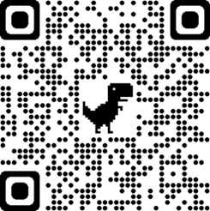
ROAD TO… COMPULSORY INTERNSHIP!
Get to know my study course regulations
When?
Where?
How long?
Which types?

Slide 15
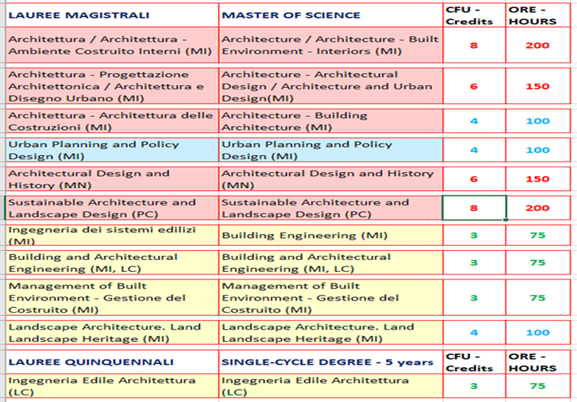
How long?
NB: The experience must be continuous:
it is not possible to add different internships’ periods.
When?
1° year or 2° year
BUT
On condition that you have inserted it in the study plan, though it is not approved yet.
N.B: COMPLETION:
To be completed and credited no later than the dead line given to close your study plan, according to your graduation session

Slide 16
Internship in a company
Internal Practical Activity
Workshop
Alternative: Work experience
Which types?
In a Company
Pubblic/Research Organisation/Institution
In a Professional Firm
Provided an expert professional supports you.
In Italy or Abroad
Where?

Slide 17
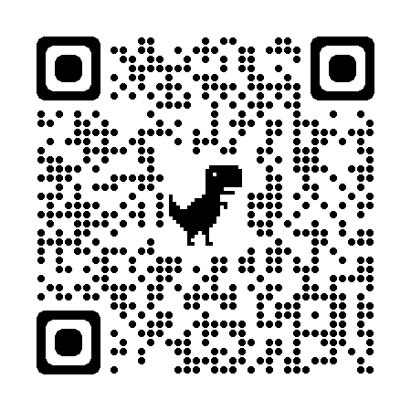
Internships during COVID-19
Internships can be carried out:
in smart working
in a mix of distance and presence mode (Green Pass compulsory)
in presence only (Green Pass compulsory)
You can find Politecnico di Milano guidelines on internships with regards to COVID-19 emergency on the Career Service website

Slide 18
Look for
How in advance?
Through which channels?
With which educational goals?
With which tools?

Slide 19
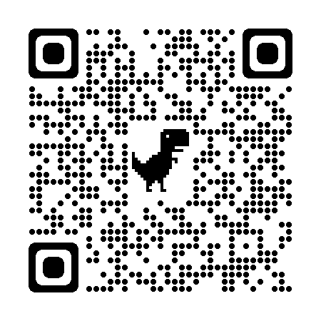
How in advance?
Start looking for
Send applications
Prepare CV and portfolio
Do interviews
Start the internship
at least 2 months

Slide 20
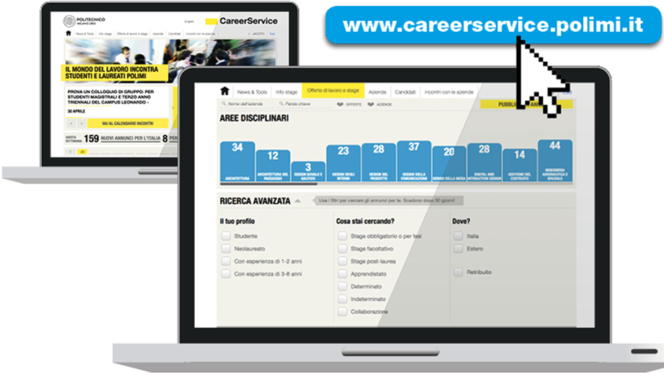
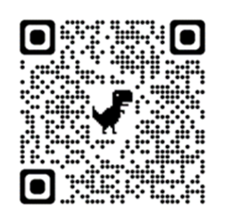
Throgh which tools?

Slide 21
Applying to the online offers on the Career Service website with my CV using the correct filters:
MY SUBJECT AREA
COMPULSORY INTERNSHIP/FOR THESIS
Discovering registered Companies for my subject area!
NEW OFFERS DAILY!
Direct contact
Autonomous applications
Professors
Alumni

Slide 22
Which internship proposals do you expect to have?
https://www.menti.com/vzypar38uj

Slide 23
Which internship proposals you can find?

Slide 24
Activate
In how long?
Though which channels?
With which documents?
Why?

Slide 25
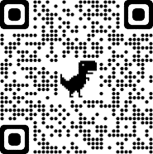
In how long?
2 CASES
5 DAYS
The internship procedure is in charge of the host organisation!
10 DAYS
If the host organisation already HAS a valid INTERNSHIP AGREEMENTS
If the host organisation DOES NOT have a valid INTERNSHIP AGREEMENT

Slide 26
With which documents?
Every internship in Italy must be activated through 2 documents:
INTERNSHIP AGREEMENT
INTERNSHIP DOCUMENT
Both documents must be provided and signed before the starting of the internship.
Why?
It’s not PoliMi that decides to use those documents for the activation of your internship, but PoliMi applies national law on internships.

Slide 27
What to do if the internship is abroad?
The Host Organisation:
can choose to follow the same procedure online on the Career Service's English page;
can ask you to sign an internship contract based ion local legislation in place of standard documents
In this case you will have to send the Career Service a copy of the contract at least 30 days in advance of the start date of the internship scheduled for the appropriate verification, approval and countersignature.

Slide 28
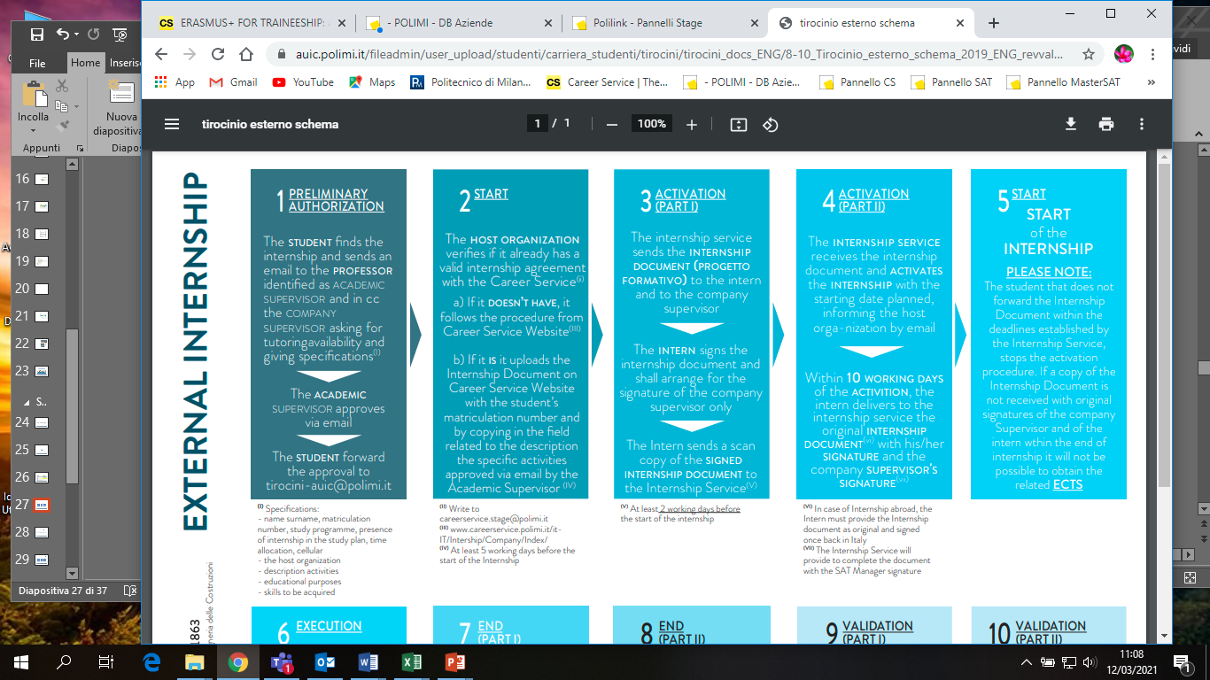
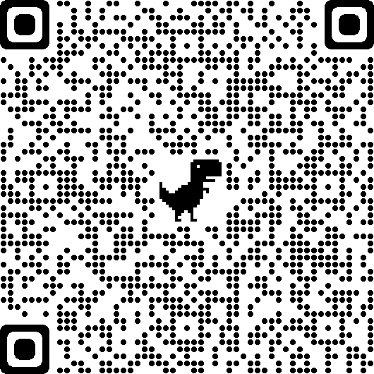
Email address of reference for Mantova Campus: tirocini-mantova@polimi.it
Email address of reference for Piacenza Campus: tirocini-piacenza@polimi.it
Email address of reference for Lecco Campus: stage-lecco@polimi.it

Slide 29
WARNING!
If you start an internship without the requested documents or before all administrative procedures are fullfilled:
You are doing a non-regular activity according to employment laws
You won’t be covered by the insurance
The internship hours done wont’ be considered valid
The internship cannot be back dated
You won’t receive ECTS for the internship nor regularly activated

Slide 30
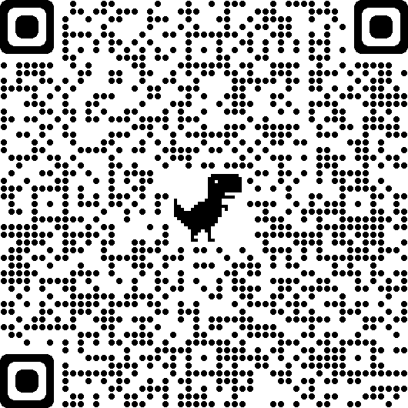
Email address of reference for Mantova Campus: tirocini-mantova@polimi.it
Email address of reference for Piacenza Campus: tirocini-piacenza@polimi.it
Email address of reference for Lecco Campus: stage-lecco@polimi.it

Slide 31
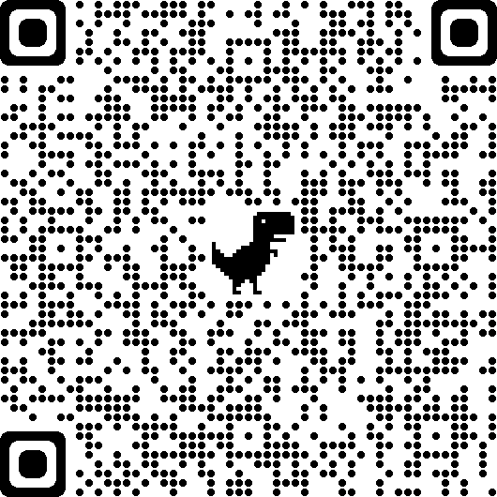
Work experience comparable to internship exception and only during the current academic career
The student sends to Internship Service 1) Copy of the agreed contract: the student must verify that on the contract are shown (or alternatively will provide them in attached) the following data: name and type of company, sector of activity, number of employees, location, name and email address of a business contact, period of activity, description of activities and tasks. 2) Final Report of comparable activity completed in all points; the specific form is available in the dedicated pages of websites of single location
The Internship Service will request the approval of the proposed activity to the SAT Manager
If the SAT Manager approves, ECTS will be validated

Slide 32
CHANGES TO THE INTERNSHIP
Travel and Suspensions can already be indicated at the time of
the completion of the internship activation request online by the host institution; any changes to these or interruptions and extensions must be communicated within a couple of days before with a special form to the competent office
BUSINESS TRIPS
SUSPENSIONS (AND POSTPONEMENT)
INTERRUPTION
EXTENSION

Slide 33
In how long?
Through which procedures?
With which documents?
Recognition of the ECTS

Slide 34
With which documents?
Simply by filling out a final internship survey! You receive a link by email on the internship’s last day!
One for you and one for the company supervisor.
Pay attention to the question that asks you to fill out a technical report on the activities done!
You cannot fill out again the technical report and the survey, once done!
Through which procedures?
Only after you and the company supervisor fill out the survey, then the academic supervisor is notified and can check both surveys (especially the technical report) and evaluate the recognition of the ECTS.
In how long?
Considering the time to fill out the survey and that of the evaluation from the academic supervisor, we advise you to end the internship at least 1 week before the supposed dead line given to close your study plan, to register for the graduation.

Slide 35
WHO DOES WHAT?
Career Service: Information on internship search
Career Service Internship Center
02.2399.2535
Follow us on Facebook
https://www.facebook.com/careerservicepolimi/
Follow us on Instagram
https://www.instagram.com/careerservicepolimi/
Drop us an email
careerservice.stage@polimi.it

Slide 36
School’s Internship Service: Information on compulsory internship regulations; compulsory internship management
tirocini-auic@polimi.it 02.2399.2604 / 2605
Staff
Claudia Cerretani Marco Ciuffini
SAT Managers
Master of Science:
Architettura: Prof. Marco Borsotti
Architettura - Ambiente Costruito Interni: Prof. Marco Borsotti
Architettura e Disegno Urbano: Prof. Laura Montedoro
Architettura - Architettura delle Costruzioni: Prof. Elsa Garavaglia
Ingegneria dei Sistemi Edilizi: Prof. Fulvio Re Cecconi
Building and Architectural Engineering: Prof. Fulvio Re Cecconi
Management of Built Environment - Gestione del Costruito: Prof. Marzia Morena
Urban Planning and Policy Design: Prof. Alessandro Coppola
Landscape Architecture - Land Landscape Heritage: Prof.ssa Laura Daglio

Slide 37
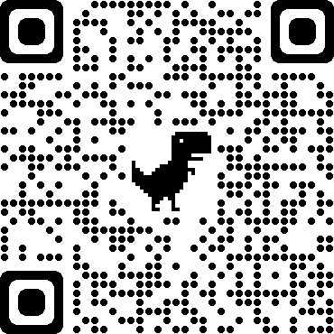
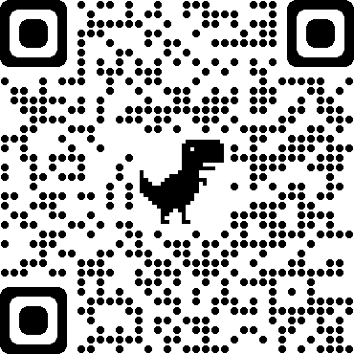
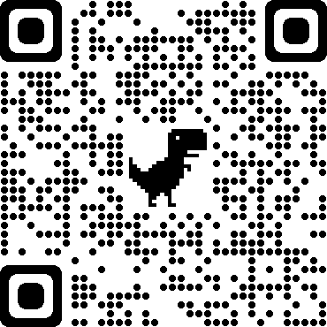
For students of Piacenza Campus: tirocini-piacenza@polimi.it
For students of Mantova Campus: tirocini-mantova@polimi.it
For students of Lecco Campus: stage-lecco@polimi.it

